Slide 1

Nicole Brown
Sarah Haley
Rachel Landers
Arwa Najmi
an American online real estate database company founded in 2006
Notes:
Hi Everyone, We conducted data analysis on data provided by Zillow found on their website. All observations are based on data provided by Zillow.

Slide 2
What is the buyer-seller index (bsi)?
Median sale-to-list price ratio
Share of listings with a price cut
Median time on market for homes in a given region and month
Two ways in which the BSI is calculated: cross-regional and cross-time
Notes:
Reflection of three other metrics
Median sale-to-list price ratio
Share of listings with a price cut
Median time on market for homes in a given region and month
Higher values indicate relative sellers market
Lower values indicate relative buyers marker
Two ways in which the BSI is calculated: cross-regional and cross-time

Slide 3
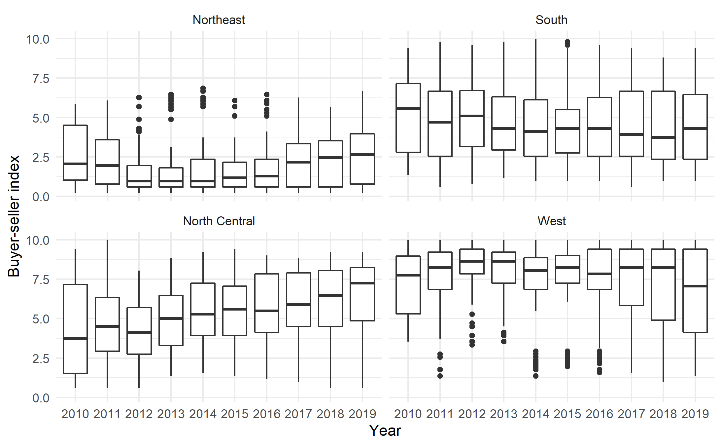
Cross-region BSI varies
Notes:
BSI patterns over the past 9 years varies by region. Northeast has the lowest median BSI scores--i.e., it’s best for buyers of all the regions, but it’s on an upward trend. The west has the highest medians, but it does appear to be in a downward trend currently. North central is currently in an upward trend. The South seems to be on a downward trend but at a lesser rate. However, whether or not you should buy or sell really depends on what your intentions are--as evidenced by the cross-time BSI.

Slide 4
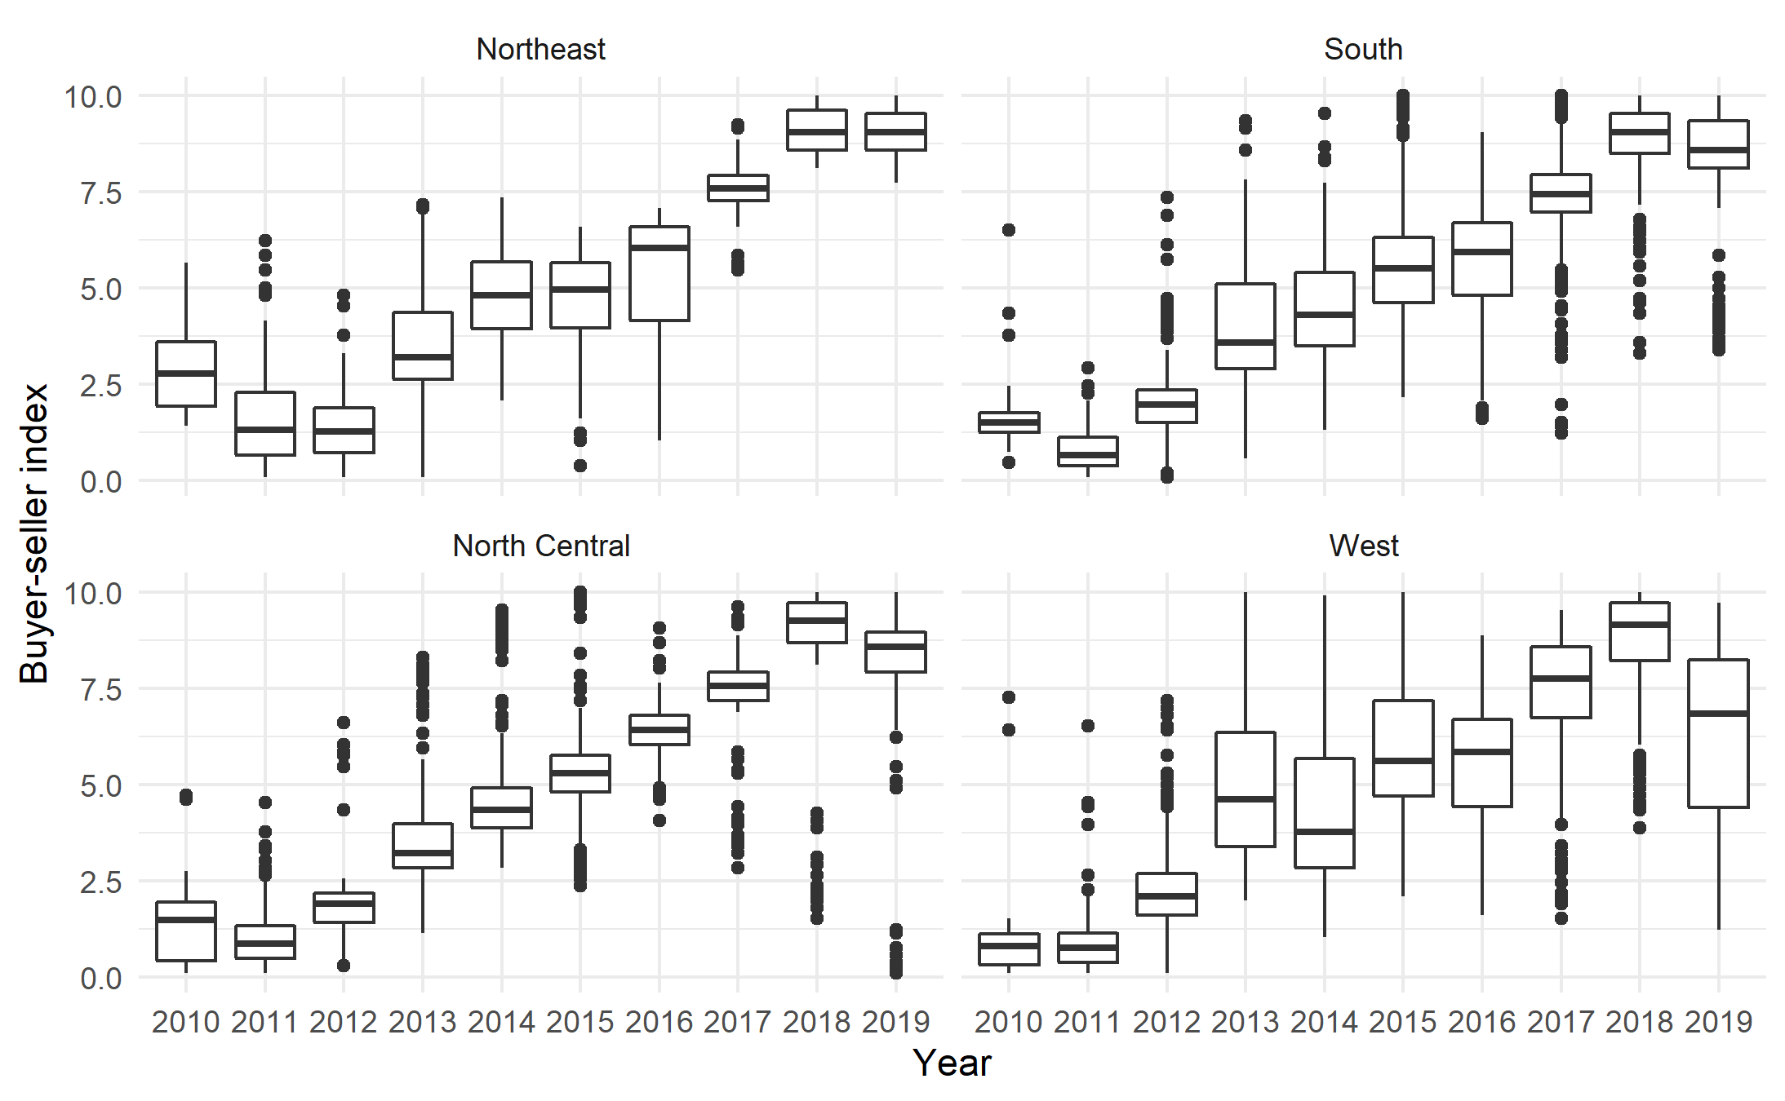
Cross-time BSI trends upward nationally
Notes:
The cross-time BSI has an upward trend nationwide. So, if you were looking to make a long-term investment, regardless of where you buy, you will likely have more leverage as a seller in the future. It’s interesting to note that the West and Northeast has quite a bit of variation throughout the years whereas the South and North Central have much more consistency.

Slide 5
Home Sales by State
States with most volatile Home Sales are:
Arizona
California
Florida
Georgia
Illinois
Ohio
Texas
Notes:
After having insight about the trends in buyer-seller behavior, we wanted to visualize where is the most volatility in home sales and how much are they going for. We faceted the home sales data by states to find that these 7 states have the most home sale volatility
We are going to look at home sales by state and Analyzing home sales by state and exploring where buyer decisions are most volatile

Slide 6
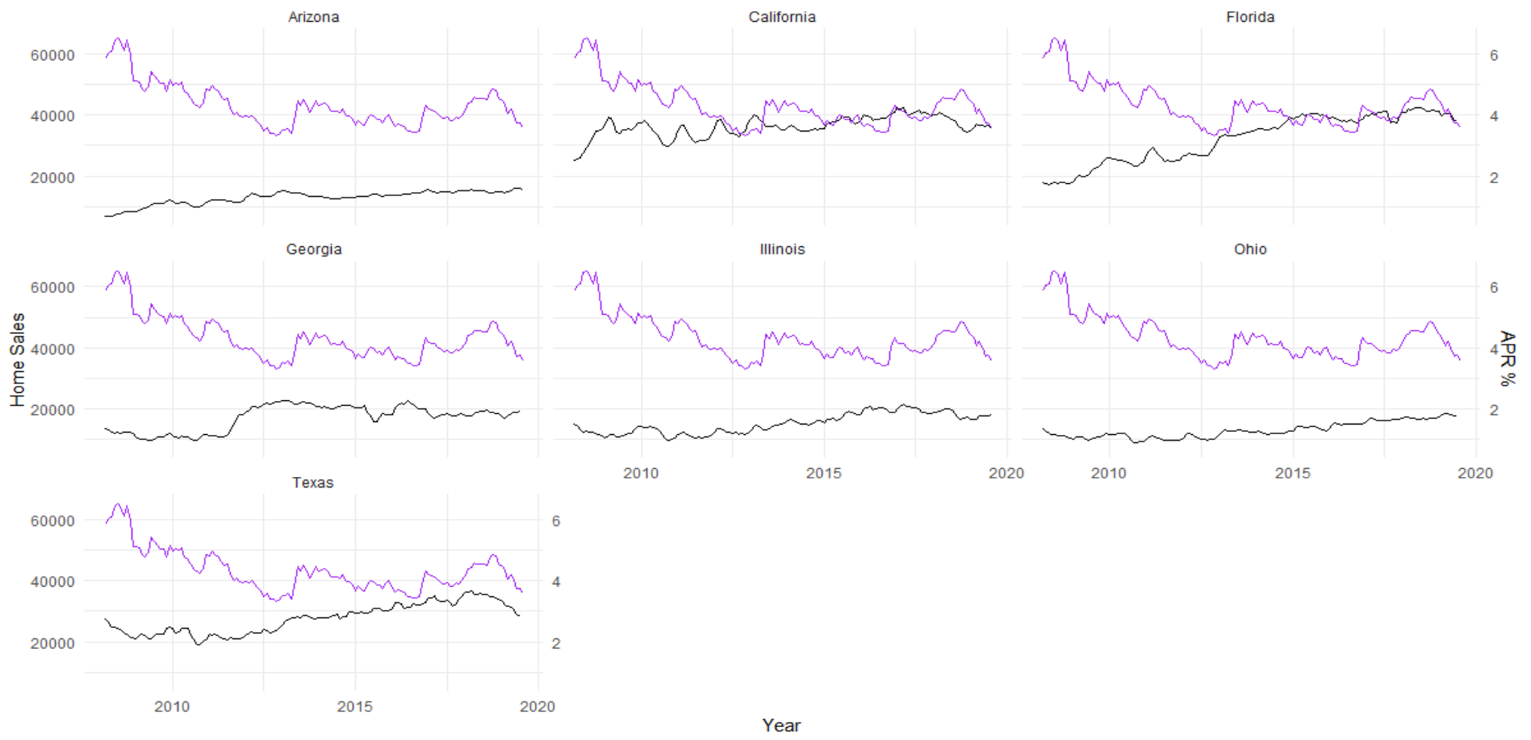
High APR discourages home sales
Mortgage Rate (APR)
Notes:
Mortgage rates go up, home sales decline
Mortgage rates decrease, home sales increase
Comparing the home sale volatility to an external factor like the 30 YR mortgage also displayed a relationship. Here, the pattern shows that High APR discourages buyers. Taking a step further and analyzing these seven states to see if they also share volatility in their home values.
After Exploring US states with most volatile home sales, which were Arizona, California, Florida, Georgia, Illinois, Ohio and Texas. Compared those states with the APR of that time, Imposing the APR line on the Home Sales, we can visually see a relationship High interest rates depress home price growth and discourage buyers.

Slide 7
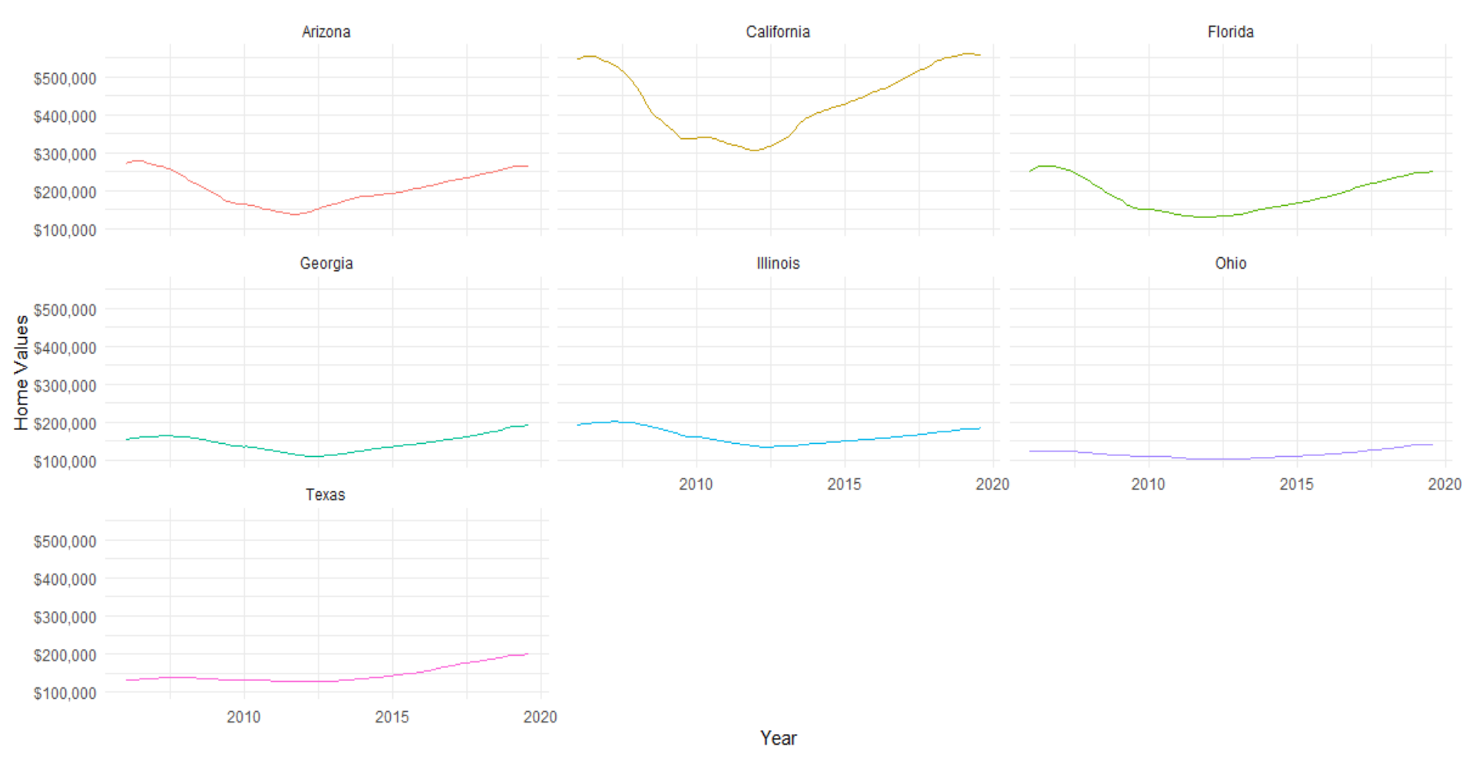
Home Values by states
Notes:
They didn’t exhibit much volatility but graphing them, We found that all 7 of the analyzed states have already reached their pre-2008 home values. Paying extra attention to Texas where we saw that Texas not only gained all its pre-2008 value around 2014 it has been rising and is close to passing an average home value of $200K which is a new high for Texas
Focus on Texas because only state that looks to pass the $200,000 average housing value and what is causing that? Which cities are causing that?
Comparing Home Values for the selected seven states show that they are all experiencing value growth and close to reach their pre-2008 value. Taking note that Average Home Value in Texas has surpassed pre-2008 and is climbing to a $200K

Slide 8
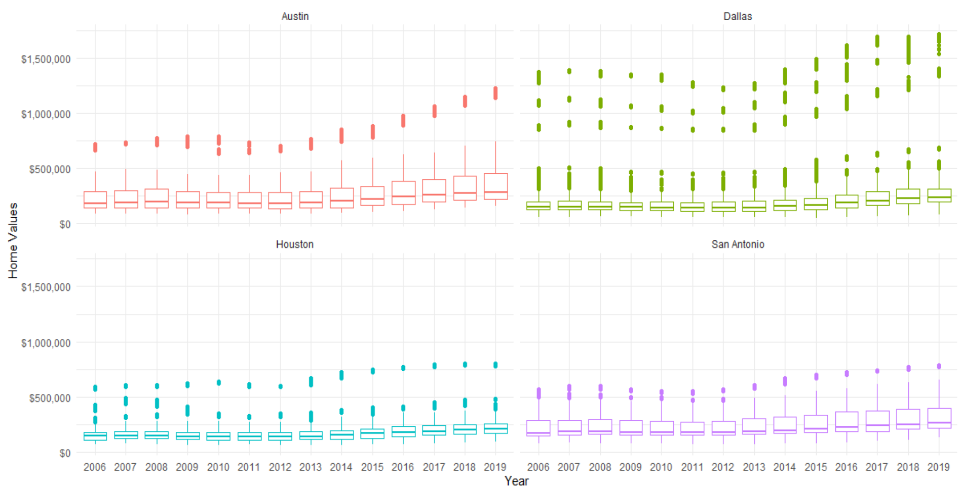
Texas in Focus
Notes:
We went to a granular level to see which cities are contributing to the rise in home values. You can see that the outliers in Dallas and Austin with home values over 1.2M are causing that skewness. Even Though Dallas has the highest average values. But according to Zillow data, Austin has the highest median home value, and San Antonio has a higher median home value than Houston. So One thing to take under advisement from this data is to not get discouraged when looking at average home values, because the entry of outliers can skew the numbers and make a city appear pricier. And Nicole will talk more about Dallas and Austin and other characteristics related to their housing market.
Deeper look Found that Dallas is causing skewness in Texas averages as it has home values that are higher than 1.5M
Also , based on Zillow data, Some insights here are that Austin have the highest median Home values and that San Antonio have higher median value than Houston.

Slide 9
Zillow Medians
Median list price
Median sale price
Days on Zillow
Median days on market of homes sold within a given month
Notes:
Days on Zillow: The median days on market of homes sold within a given month

Slide 10
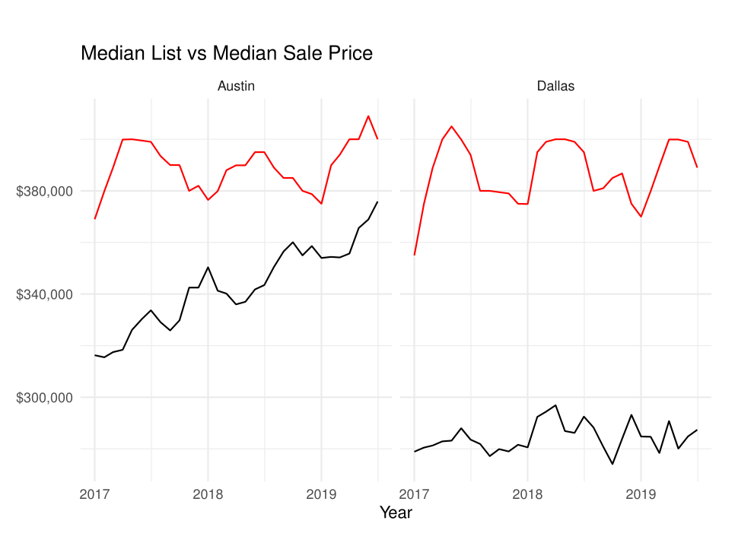
Med List Price
Med Sale Price
Notes:
Continuing our dive into TX, let’s take a quick peek at Austin vs Dallas Median List and Median Sale Prices before moving on to some days on zillow data.
Looking at the graph it would appear that Dallas has higher Med List prices, we can be fairly confident in this because medians are used which reduces the distortion caused by outliers. What we can really take away from this data is that there is evidence to support the idea that Austin consistently has higher median sale prices. This could potentially speak to the income levels of Austin inhabitants but it most certainly backs up our previous graphs showing Austin’s higher home values.

Slide 11
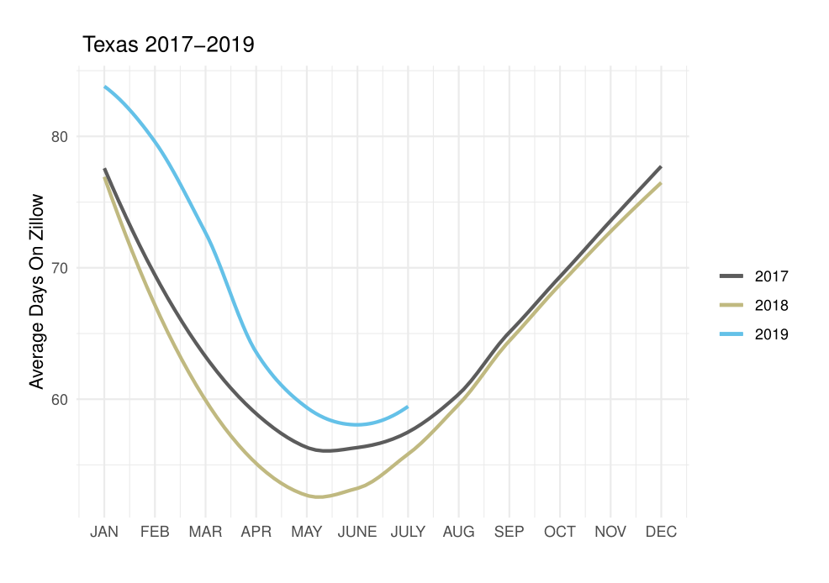
Notes:
So far we have identified which regions to buy and sell in based on the buyer seller index, and looked at how home values and Median List vs Sale prices vary across multiple states and Texas in particular. Now Let’s switch our purview a bit and look at average days on Zillow. While we are again focusing on TX and our graph shows that days on zillow are typically at lowest for TX during Apr-July, we can confirm that Zillow data in its entirety shows this trend nationwide. So let’s again go to the Austin vs Dallas perspective

Slide 12
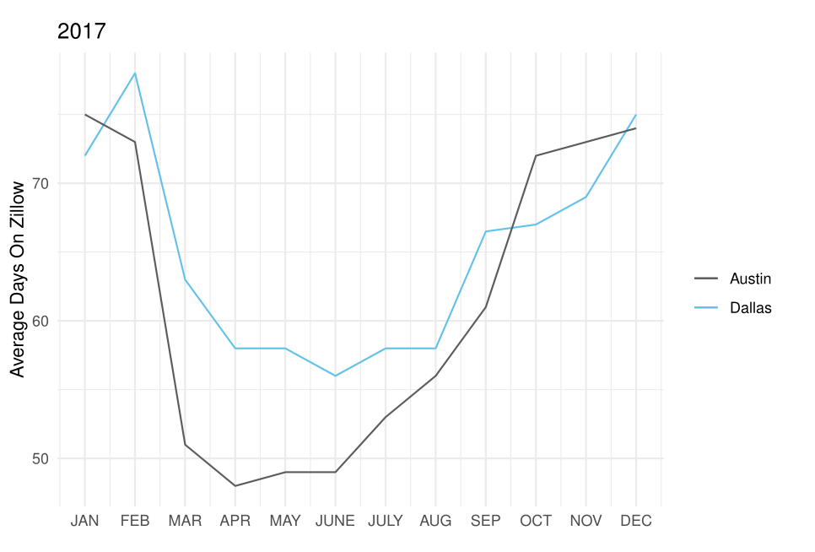
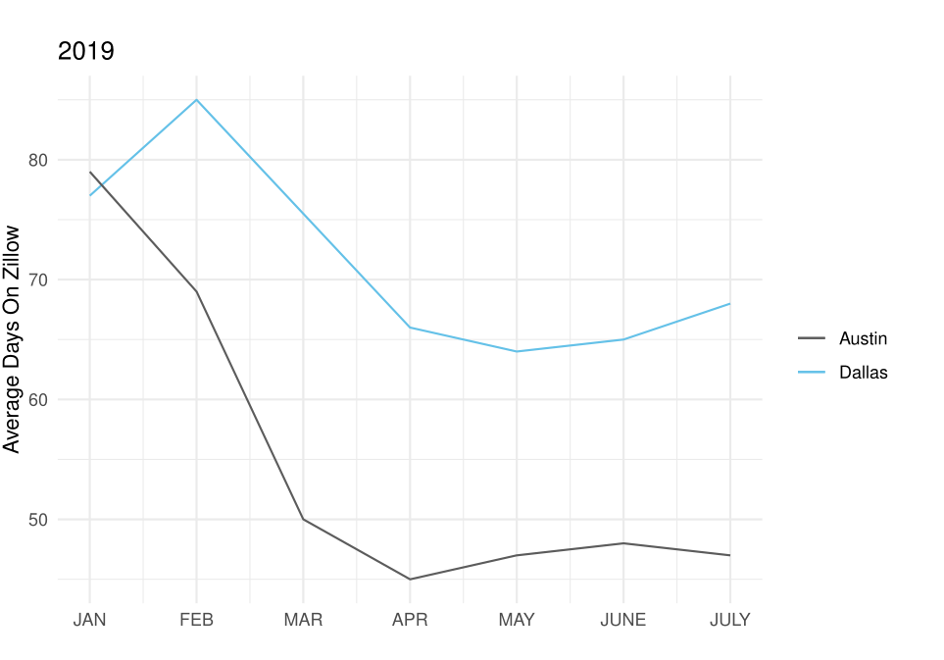
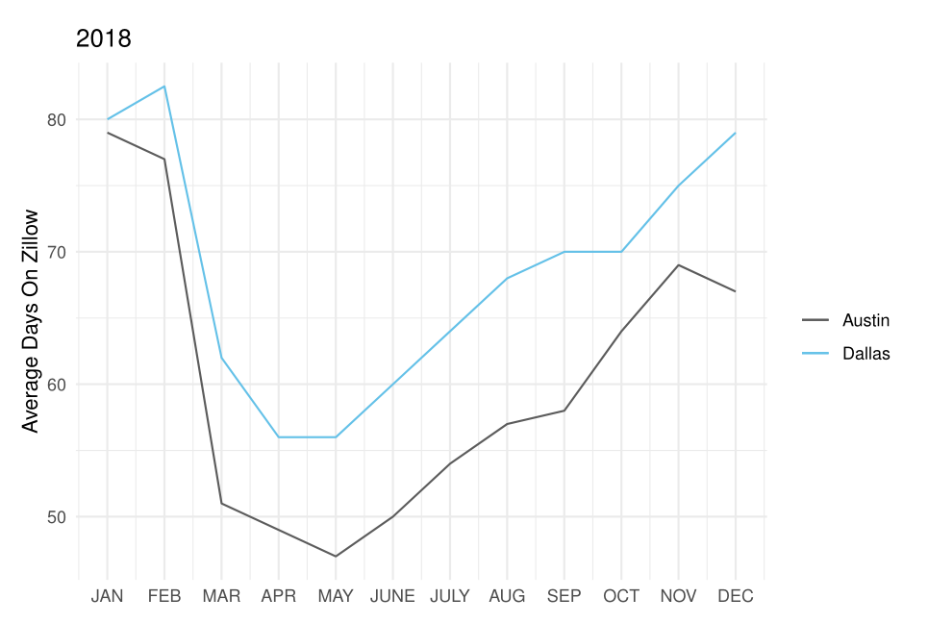
Notes:
Dallas has higher days but both show same seasonal dip. What is interesting to note for me is that Austin home values are higher than Dallas but Austin Days on Zillow are lower. This seems to lend credibility to the idea that Austin is a hot market right now. So 2 takeaways from these last few graphs. 1. Austin prices are higher so this should be taken into consideration when buying. Anyone buying may need some wiggle room for bidding wars. 2. If a seller wants a lower list to sale time then they should wait and list the house between Mar-Apr. This could happen for many reasons. For example: Perhaps they are going to use proceeds on their sale for a new home and can’t wait a long time for turn around. I am going to pass the mic to Sarah who is going bring into focus an interesting concept: how the Zillow data shows historical market patterns pre- and post 2008 recession.

Slide 13
Concern: End-of-Cycle Economics
Zillow Home Value Index
How will the next recession impact home values?
A smoothed, seasonally adjusted measure of the median estimated home value across a given region
Notes:
According to a forbes article published in July 2019, The markets with the fastest growth in price fell the hardest in the past year with Some exceptions bucking the norm (https://www.forbes.com/sites/carolinefeeney/2019/07/01/halfway-into-2019-how-is-the-housing-market-holding-up/#2658ddb43ec5)
Also
“Demand is also tied to homebuyer sentiment, which isn't necessarily strong right now. In June, consumer confidence dropped 9.8 points to the lowest level since September 2017 as a result of tensions surrounding the trade wars, according to the Conference Board.
“Consumers are picking up on that lack of certainty about the economic outlook,” said Danielle Hale, Chief Economist at realtor.com. “And that's not necessarily going to inspire them to make large purchases like a house.””
Think - agents need to CONVINCE home buyers that buying a home is a good idea, whereas in past generations it was assumed

Slide 14
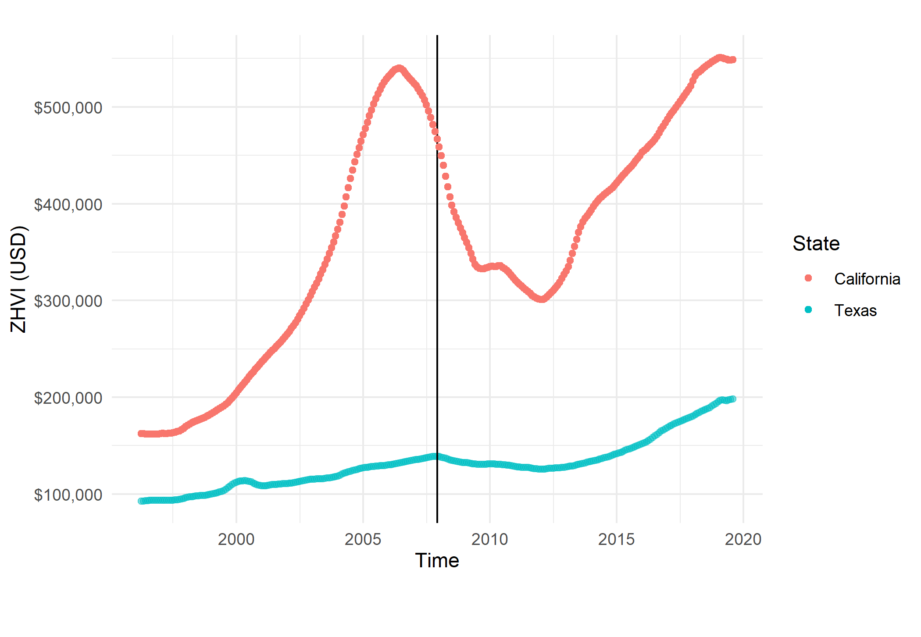
Texas & California: Zillow Home Value Index
‘08 Recession

Slide 15
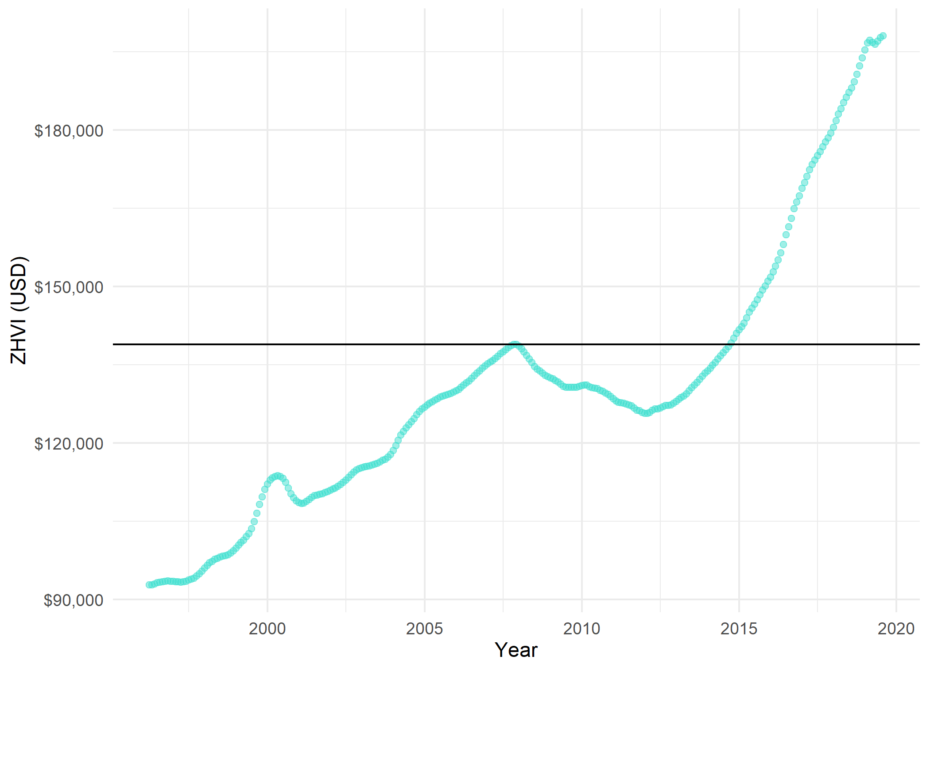
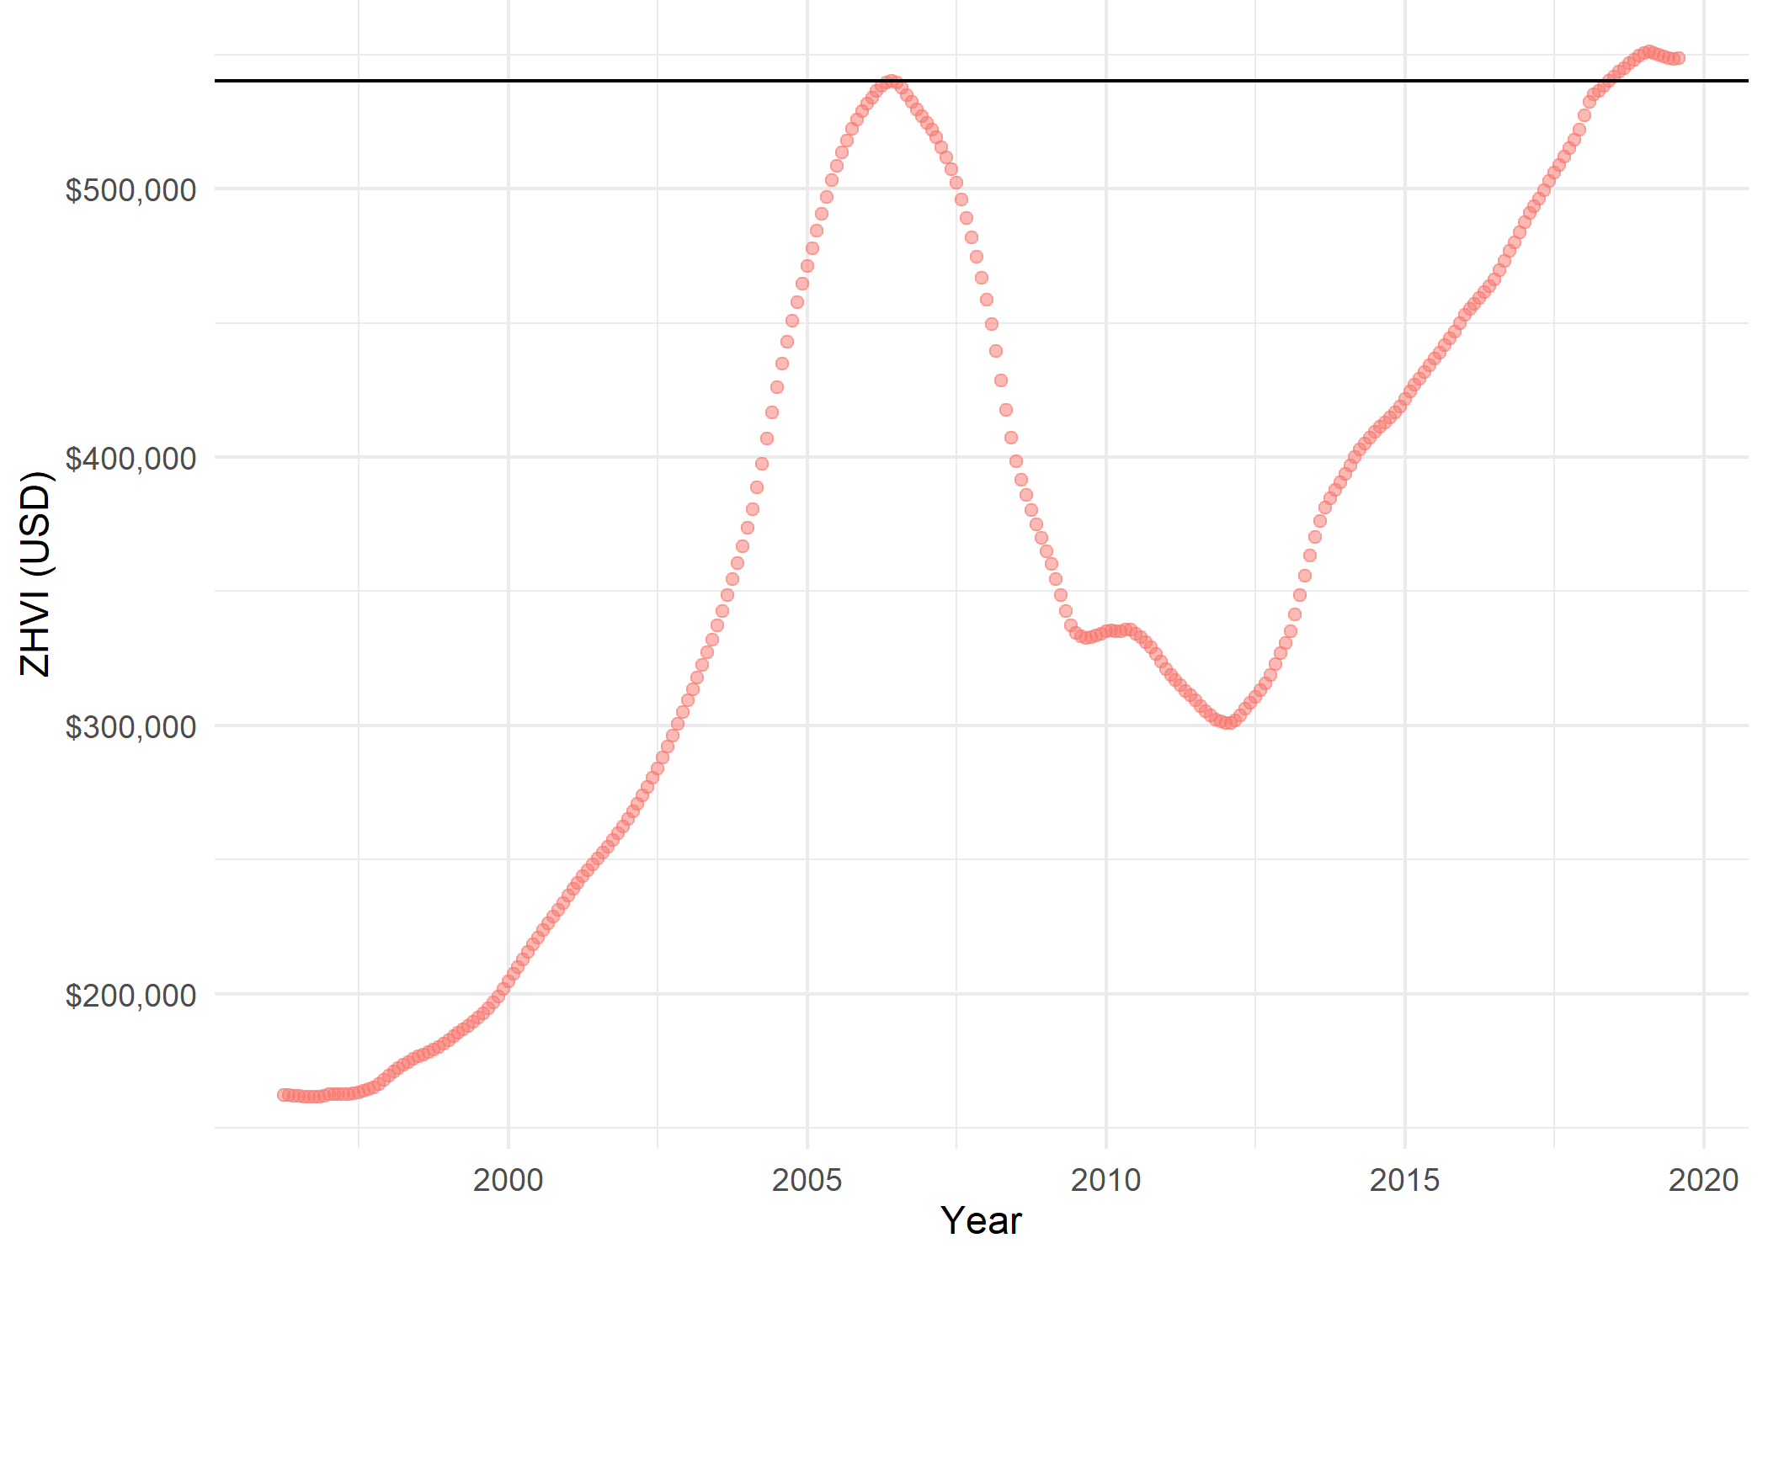
Texas:
Faster Recovery,
Long Term Growth
California:
Drawn-out Recovery,
Stalling Growth
Pre-Recession
ZHVI Maximum
Notes:
Cali recovered in June of 2018
Texas, October 2014

Slide 16
Concluding Thoughts
Sell West, buy Northeast
Median Home Values important when house hunting
March to July for fastest sale
Hot markets not always best long term investments

Slide 17
Nationwide Buyer-Seller Index over Time

